Slide 1
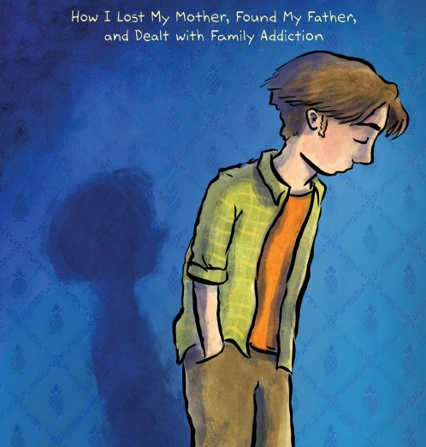
HEY, KIDDO
Jarrett J. Krosoczka
Olivia Godoy
ENG 375 – 4/7/22

Slide 2
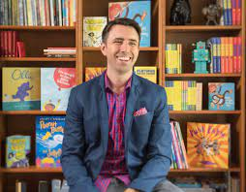
Jarrett J. Krosoczka
Awards – Hey Kiddo
Finalist, National Book Awards 2018 for Young People's Literature
Finalist, National Book Award, Young People’s Literature
Harvey Award Book of the Year
New York Times Notable Children's Books of 2018: Young Adult
Time 10 Best Books of 2018 (YA & Children's)
Los Angeles Times Book Prize Finalist, Young Adult
YALSA Nonfiction Finalist
New England Book Award
Author and Illustrator of Hey Kiddo
Born December 22, 1977
Worcester, Massachusetts
Joe and Shirley (grandparents), Leslie (mother)
Married with one child
“J.” is a tribute to his late grandfather
Scholarship
provides tuition help for “underprivileged children who are in unique familial situations”
in honor of his late grandfather
Other Awards
Two-time winner- Children’s Choice Book Award for the Third to Fourth Grade Book of the Year
Eisner award nominee
Notes:
First, I wanted to introduce our author since he is also the main character of this graphic novel. It is always helpful to know a bit about the author’s background, but here we have actually learned it through his autobiographical graphic novel, so I wanted to remind of a few things. Also, here I have listed some awards he has won for Hey, Kiddo and other books, however, not all are listed here since records of awards are spread out and it is not necessary info. I just wanted to show how he has been successful in his work and others have recognized this, so consider this as some of you may wish to write but fear “not being good enough”, you will never know unless you try.

Slide 3
Graphic Novels
Why Read/Teach Them?
Accessible to learning, struggling, and reluctant readers
Ability to discuss various topics with visual context
Written as complete narratives
Requires analysis of pictures, text, and both together
What’s Different?
Comics- excerpts of serialized narratives, panels
Manga- Japanese texts, strong storylines, slower pacing, read right to left, released in volumes
What are they?
“juxtaposed pictorial and other images in deliberate sequence, intended to convey information and/or to produce an aesthetic response in the viewer”
-Scott McCloud
What’s the controversy?
Graphic Novels “are”:
too easy with pictures
not real literature
Doesn’t require same close reading/analysis
Notes:
p. 50? Scene where he goes into his moms room, the letters, facial expressions, art etc

Slide 4
Graphic Novels Can Be (Auto)biographical
Why?
Ability to provide personal images
Books can be multimodal or multi-genre
Topics discussed/depicted are unavoidable
What does this mean?
Graphic Memoirs = Graphic Novel subgenre
Promotes taking creative risks
Why is this important?
Allows readers to connect in ways they might not with just the text
Graphic Memoirs elevated the status of Graphic Novels (ex. Maus)
Example Texts
Hey, Kiddo- Jarret J. Krosoczka
Maus- Art Spiegelman
American Born Chinese – Gene Luen Yang
Stitches- David Small’s
Blankets- Craig Thompson
Mom’s Cancer- Brian Fies
Flying Kites: A Story of the 2013 California Prison Hunger Strike - Stanford Graphic Novel Project
Notes:
https://www.illustrationhistory.org/genres/graphic-novels-visual-memoir-and-autobiography

Slide 5
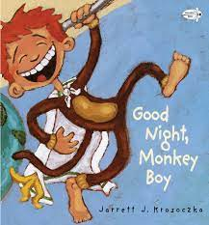
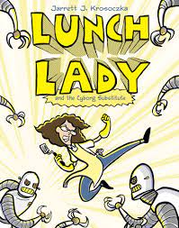
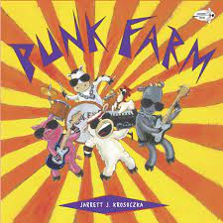
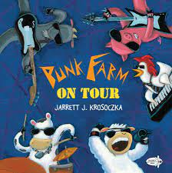
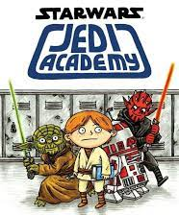
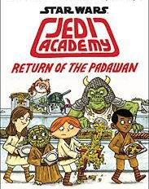
Other Texts By Krosoczka
Younger Texts
Middle Grades
Good Night, Monkey Boy
Lunch Lady (10)
Peanut Butter and Jellyfish (animated film)
Bubble Bath Pirates!
Punk Farm
My Buddy, Slug
Comics Squad (3)
+More
Star Wars: Jedi Academy (6)
Platypus Police Squad (4)
Young Adult
Hey, Kiddo
Sunshine (not yet published)
Notes:
Before getting into Hey, Kiddo, I wanted to show some of the other texts that this author has written. Most are for younger grades (under 11) so here is just a short list. Some well-known texts are “Good Night, Monkey Boy”, his “Lunch Lady” series, and “Star Wars: Jedi Academy” series. Of course we are familiar with his graphic novel Hey, Kiddo, but the rest are more picture book or comic style. This is important to know because as an author, he did not limit himself to one style or age group and showed success in taking risks. So as future teachers, writers, and what have you, this is one of the most important lessons I have learned.

Slide 6
Hey, Kiddo – Who is it for & Why?
Suggested either: 12+ or 14+
Challenged
By Parents in Iowa
For “excessive vulgarity”
Challenger – language is disturbing, not the message
"If my student walked into the principal's office and called any teacher one of these names, they'd be disciplined immediately… So why is it okay for them to read it?"
Due to… “inappropriate words, inappropriate behaviors, sex, drugs, alcohol, stealing, infidelity, and murder”
But… “These are all things that Krosoczka was mindful of, which is why he did not write it for the very young.”
“It is unfortunate that this book was challenged. This is a very real issue that is impacting more and more children.”
Notes:
https://www.oif.ala.org/oif/authors-new-to-the-challenged-list-jarrett-j-krosoczka-meredith-russo/
https://authorsunbound.com/eventnews/2021/11/23/banning-books-has-authors-reacting-and-responding
https://www.albanypubliclibrary.org/blog/author-illustrator-jarrett-j-krosoczka-discusses-challenged-book-hey-kiddo-on-sept-28/
So Hey, Kiddo, who is it for? Well tell me what you think…….
Yeah… I think this is better for high school or college audiences due to the subject matter and reasons for censorship, but we’ll come back to that later. The text seems fitting for younger grades due to the pictures and simple language structures, but the content could be intense/mature for young readers. So, how is this text accessible?
The content may be heavy, yet the book is not. There are moments of light-heartedness and scenes that bring smiles to my face rather than sadness. This book does not tell a sob story to ask the reader to connect. This book tells a true story and asks people to connect through our human experiences. For instance, dealing with sports vs art or deciding which school to go to based on friends or experience are common occurrences in our lives.
https://www.npr.org/2018/10/16/657772230/hey-kiddo-aims-to-help-kids-with-addicted-parents-feel-less-alone

Slide 7
Selected Quotes
“There are a lot of empty plots at the bottom of the hill. Maybe that’s where I will go someday. It would only make sense for me to end up near them—they raised me, after all. And my mother? Who knows where she’ll end up. Honestly, it’s surprising that she isn’t here already. And my father? Who knows if I’ll ever even meet the guy before either of us make it to the grave.” (Prologue, P. 11)
“None of us are dead yet. But it’s unavoidable in the end.” (Prologue, P. 9)
“When you don’t see your mom that much, you treasure anything that she gives you” (Ch. 3, P. 84)
“My mom didn’t even come around for my birthdays… I always felt the void Leslie’s absence created” (Ch. 3, P. 92-93)
Notes:
“Stories keep memories alive and people real to us.”
Susina – what quotes are you discussing/should I?
Ch. 1 – Prologue – cemetery
Ch. 2 – Joe and Shirley & kids stories
Ch. 3 – Leslie, grandparents, new school, Pat, sports vs art, hamster
Ch. 4 – Shirley falls, nightmares (more), Disney, told him about mom, tells pat
Finds out truth about mother – p. 132-133
“I knew in that moment, when my grandfather told me the plain truth, that life wouldn’t be the same for me. It didn’t change the circumstances, but it shifted my perspective” p. 134 → told pat 140-141
Ch.5
Art museum/class
Mother O.D. in paper p. 159-161
Find out father name 166-167
Grandparents find out about parents day (172)
Yearbook (175-6)
Ch. 6
New school (186) → art class (192) DONNA STONE quote
Published cartoon in paper (202) & mural (204-205)
Ch. 8
Got letter from dad (252) → wrote back bc curious about siblings (265) → brother and sister (266-269)
Angry at mom for mothers day bc didn’t give her a card since she hadn’t been there (she was upset) (274-275)
Drove to dads (276)
Rejected from risd → drove to dads again

Slide 8
Censorship
“There are books for young people that hold difficult truths… I didn’t pull any punches because of one simple realization: There are difficult truths in our books because there are difficult truths in children’s lives.”
Maus was challenged for inappropriate depictions
The Will Smith slap was censored, but not on Japanese television
Classic texts are often censored/challenged, but modern texts are as well
So… tell me what you think
“It certainly isn’t up to me to tell parents what their child should and shouldn’t read, but I do know this: There are some very difficult and inconvenient topics our children are going to face in real life.”
Notes:
https://youtu.be/_k0ywFgMpFk
Quote 1: “and we gatekeepers — writers, parents, teachers, librarians — often find ourselves trying to sort out just what is appropriate for our kids to read about…”
Krosoczka wrote in an article for The Washington Post in 2018.
Quote 2: I so hope that our young people can experience and learn about these difficult truths for the first time on the page and not in real life. The windows that books provide may give them warning and steer them in a positive direction.”
Now that we have discussed some of the importance of censorship, I want to know how you feel about the book’s challenging, and if you would consider this in classroom curriculum or a classroom library? What is your stance?

Slide 9
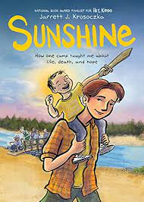
Sunshine (not yet released)
How did this novel come to be?
David Levithan recommended that Krosoczka write a novel
Fits into chronological narrative
Story was a turning point for author
Digitized memories
vhs footage
Saved artifacts for chapters
Revisited journals
Similar Covers
to show “of the same fabric”
More optimistic tone for Sunshine
Show growth in age
Read rough drafts to campers
their appreciation gave confidence he needed to keep trying
NOT a sequel to Hey, Kiddo
Story stands on its own
Deepens readers connection and understanding of gap in the story
How to read with Hey, Kiddo
Read up to page 262
Read Sunshine
Return to and finish Hey, Kiddo

Slide 10
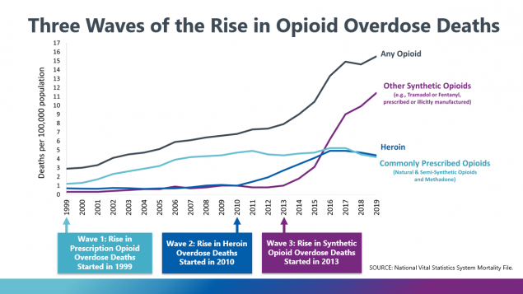
Connections
Media
Fangirl
The Hate U Give
Euphoria
Opioid Epidemic
“most widespread and deadly drug epidemic this country has ever known. Since 2000, it has claimed more than 300,000 Americans”
“Over 70% of the 70,630 deaths in 2019 involved an opioid”
CDC is taking measures to inform, research, providing safe and educated opioid prescriptions, and prevent misuse
Notes:
https://oomscholasticblog.com/podcast/hey-kiddo-conversation-about-family-addiction-and-art
https://www.cdc.gov/drugoverdose/epidemic/index.html

